Slide 1



CSE 2213:
Discrete Mathematics for Computer Science I
Modified Slides (based on the source mentioned below):
Originals slides by Dr. Baek and Dr. Still, adapted by J. Stelovsky
Based on slides Dr. M. P. Frank and Dr. J.L. Gross
Provided by McGraw-Hill

Slide 2


Exercise I
 From 6 CS faculties and 4 EE faculties, a committee of 6 is to be formed. In how many ways can this be done if the committee contains (i) exactly 2 EE faculties, or (ii) at least 2 EE faculties?
(i) C(4, 2) × C(6, 4)
(ii) (C(4, 2) × C(6, 4))+(C(4, 3) × C(6, 3))+(C(4, 4) × C(6, 2))

Slide 3
Exercise II
 If a student writes random strings of length 3 using the vowels (A,E,I,O,U) only, how many times he is required to write such strings to be sure that he has written a string twice?
Length 3: _ _ _
So, at least (5 × 5 × 5) + 1 times

Slide 4
Exercise III
 If a librarian picks 5 Calculus books from 7 different Calculus books and 4 different Discrete Math books from 6 different Discrete Math books, how many ways he can arrange these 9 books on a shelf such that a Calculus book is at the beginning and a Discrete Math book is in the middle? [Note: each of the Calculus or Discrete Math books is written by different writers]
C _ _ _ D _ _ _ _
C(7, 1) × C(6, 1) × C(6, 4) × C(5, 3) × 7!
** The first one is chosen. Then, the rest are chosen. Choose 4 Calculus books from remaining 6 and choose 3 DM books from remaining 5.

Slide 5
Exercise IV
 How many strings (considering only lowercase letters) are there of length five or less that begin and end with the letter "a"? (Do not consider empty string).
Number of strings of length five (strings of the form “a _ _ _ a”) = 26³
Number of strings of length four (strings of the form “a _ _ a”) = 26²
Number of strings of length three (strings of the form “a _ a”) = 26
Number of strings of length two (“aa”) = 1
Number of strings of length one (“a”) = 1
Total possible strings: 26³ + 26² + 26 + 1 + 1

Slide 6
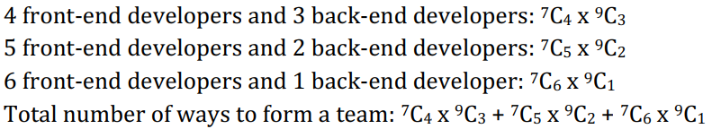
Exercise V
 Suppose that a software company has 7 front-end developers and 9 back-end developers. A standard team is formed by having at least one front-end developer and at least one back-end developer. How many ways are there to form a standard team of seven members so that it must have more front-end developers than back-end developers?

Slide 7
Exercise VI
 In a game of UNO, there are cards of 4 colors- red, green, blue and yellow. There are 25 cards for each color (there are some special cards, but we will not be considering them now). A player has dealt 7 cards in a round. Now using the pigeonhole or generic pigeonhole principle, do the following:
i. Explain why there is no guarantee that a player will get at least 2 blue cards.
ii. Minimum how many cards should be picked to ensure that he gets at least 3 cards of the same color?

Slide 8
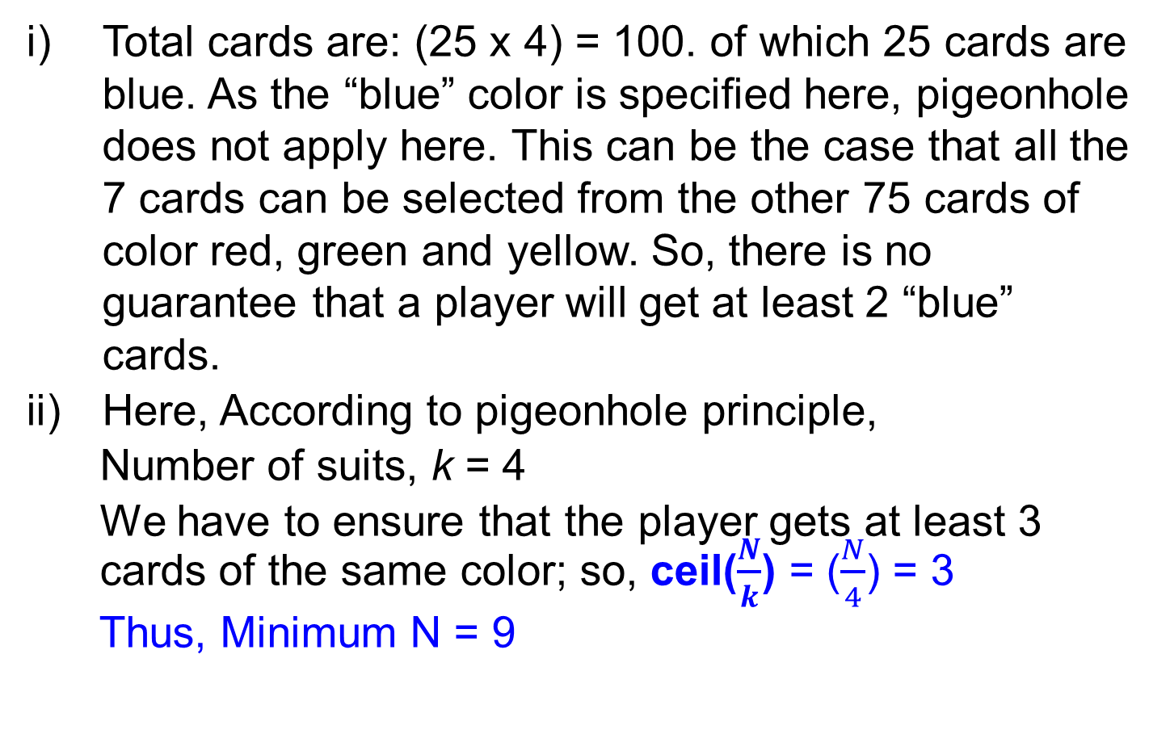
Exercise VI - Solution
Total cards are: (25 x 4) = 100. of which 25 cards are blue. As the “blue” color is specified here, pigeonhole does not apply here. This can be the case that all the 7 cards can be selected from the other 75 cards of color red, green and yellow. So, there is no guarantee that a player will get at least 2 “blue” cards.
Here, According to pigeonhole principle,
Number of suits, k = 4
We have to ensure that the player gets at least 3
cards of the same color; so, ceil($\frac{N}{k}$) = ($\frac{N}{4}$) = 3
Thus, Minimum N = 9

Slide 9
Exercise VII
The marvelous chocolate company makes 16 different flavors of chocolates, each of 3 different sizes - large, medium and small. The company makes gift boxes on special occasions which contain eight chocolates - all of different flavors. The boxes also contain chololates of different sizes - three small chocolates, three medium ones and two large ones. How many ways can the chololate boxes made?

Slide 10
Exercise VII - Solution
To get the number of ways the chocolate boxes can be made, we can use the combination formula for selecting chocolates from each size group.
The number of ways the small chocolates can be selected is:
C(16,3)
The number of ways the medium chocolates can be selected is:
C(13,3)
The number of ways the large chocolates can be selected is:
C(10,2)
To get the total number of ways to make the chocolate boxes, we multiply the three combinations:
C(16,3) × C(13,3) × C(10,2)
Hence, the total number of ways the chocolate boxes can be made is: 20,736,000.

Slide 11
Exercise VIII
Suppose that, BRTC is introducing a new type of numberplates for electric cars in Bangladesh that is in the format W-XXXX-NNNN, where X is any English letter (case sensitive) and N is a digit. W is a special character that can be either ‘F’ or ‘B’. Now,
calculate how many different license plates are available if:
i. Letters (X) and Numbers (N) cannot be repeated.
ii. Letters (X) can be repeated, but numbers (N) cannot be repeated.

Slide 12
Exercise VIII - Solution
i. W-XXXX-NNNN
Letters and numbers cannot be repeated
26 letters, case sensitive; so, total possibility: 2x26=52
2 x 52 x 51 x 50 x 49 x 10 x 9 x 8 x 7 (ANS)
ii. W-XXXX-NNNN
Letters can be repeated but numbers cannot be repeated
26 letters, case sensitive; so, total possibility: 2x26=52
2 x 52 x 52 x 52 x 52 x 10 x 9 x 8 x 7 (ANS)

